Slide 2
Mercurial 201
Today’s Presenter:
Katie
Where to find these slides:
https://fburl.com/vgrns4ex
Notes:
Can you see the slides
Im katie
You guys were probably auto muted on entry, please keep your self muted unless you have a question
Please ask questions, just interrupt me or you can try the hand raising thing
Let me know if im going to fast or if you want me to go into more detail
These slides are available in our teams dropbox, ill leave this link up for a sec if you want them, also in team dropbox
Add a slide about getting help
Source control

Slide 3
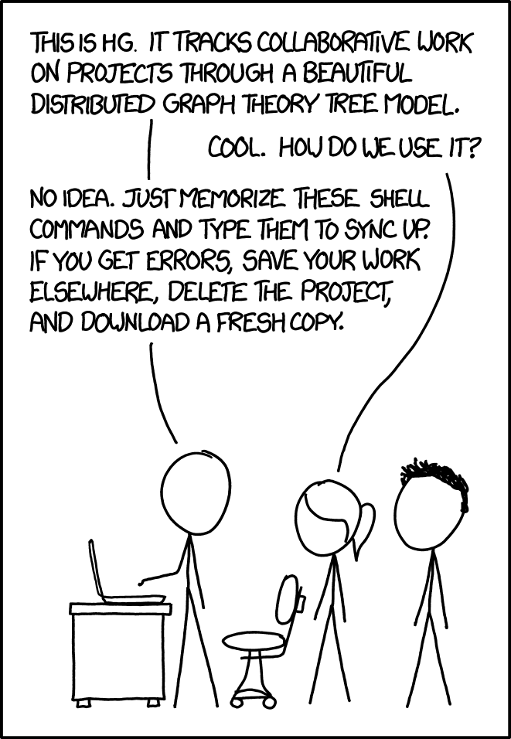
Source: https://xkcd.com/1597/

Slide 4
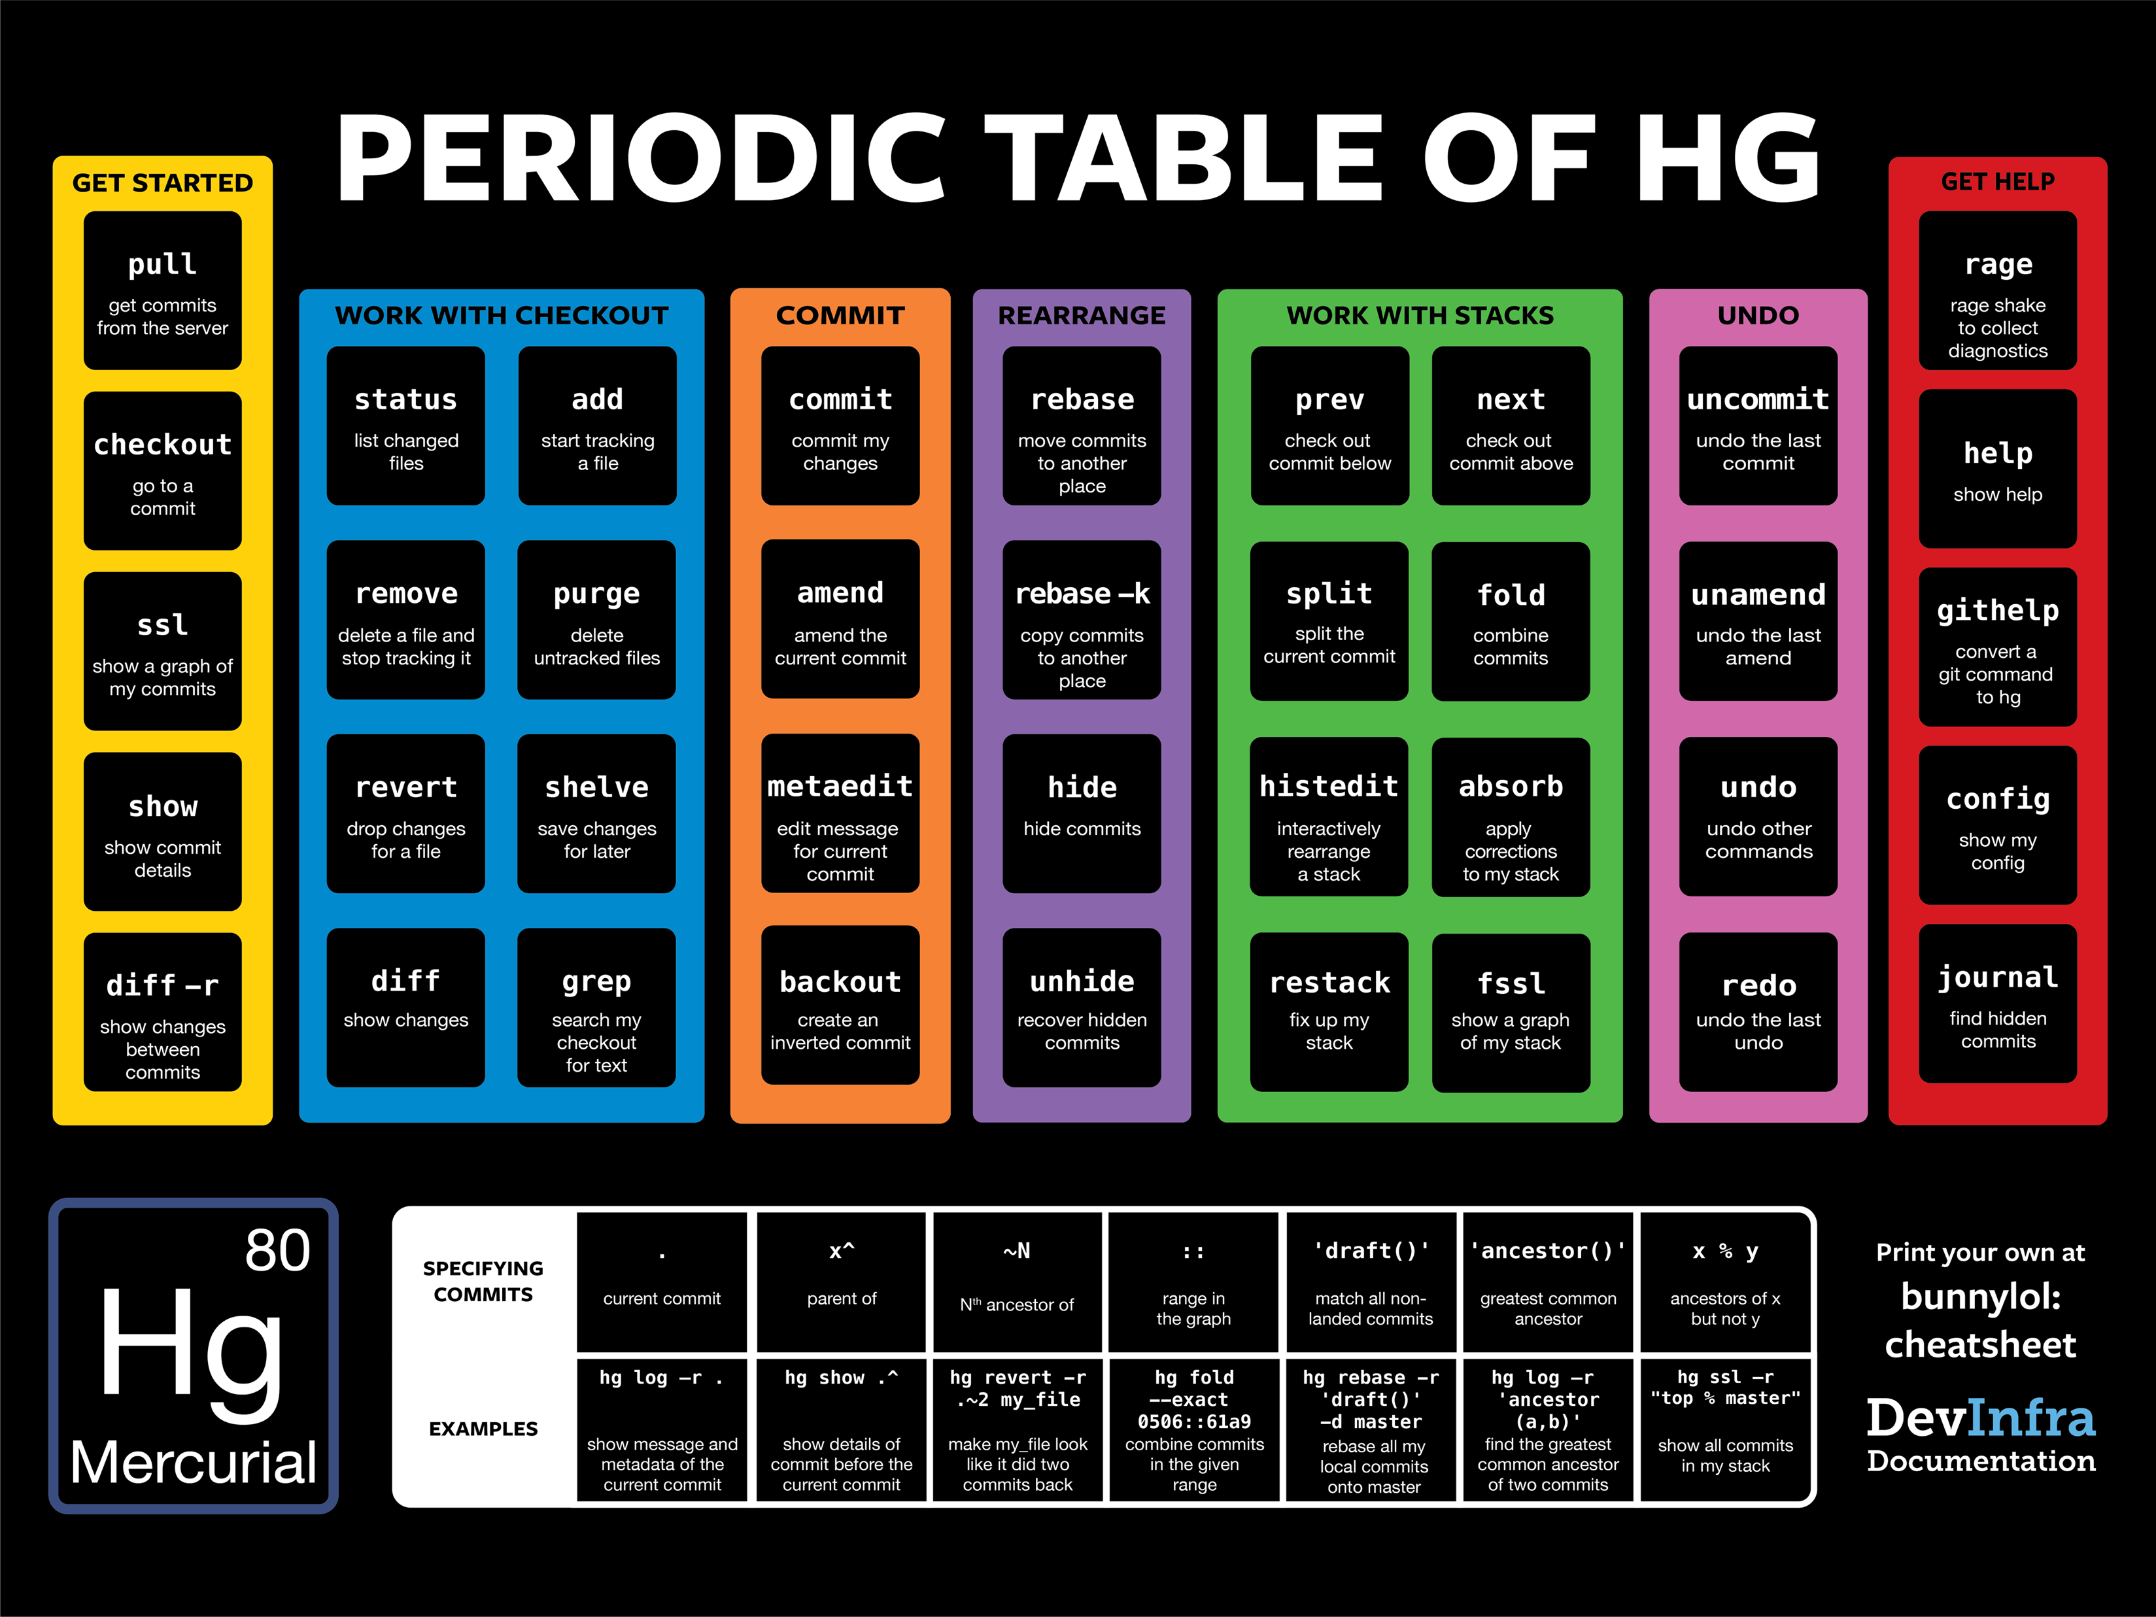

Slide 5
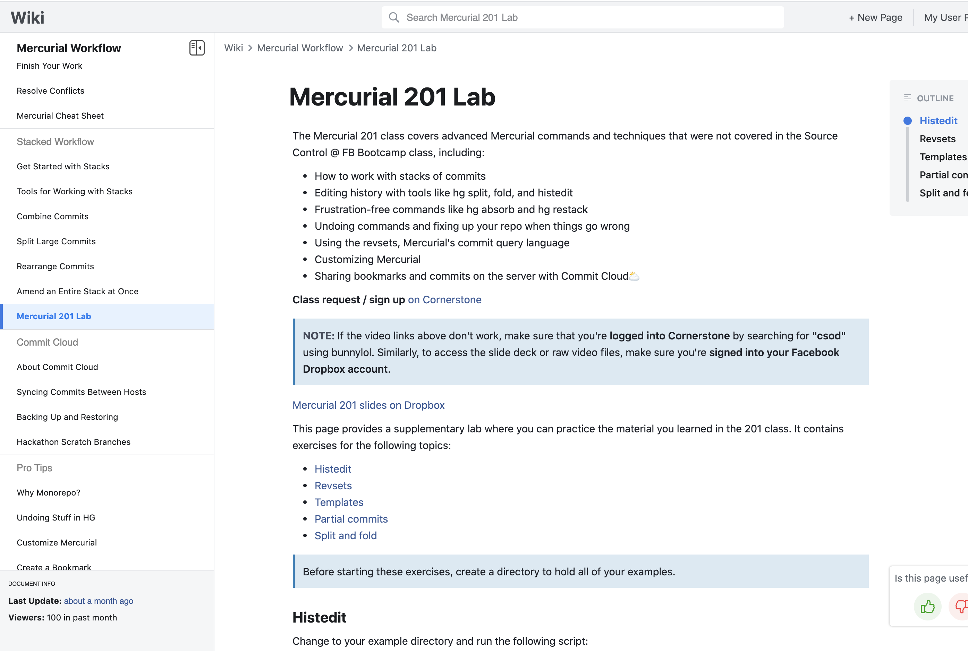
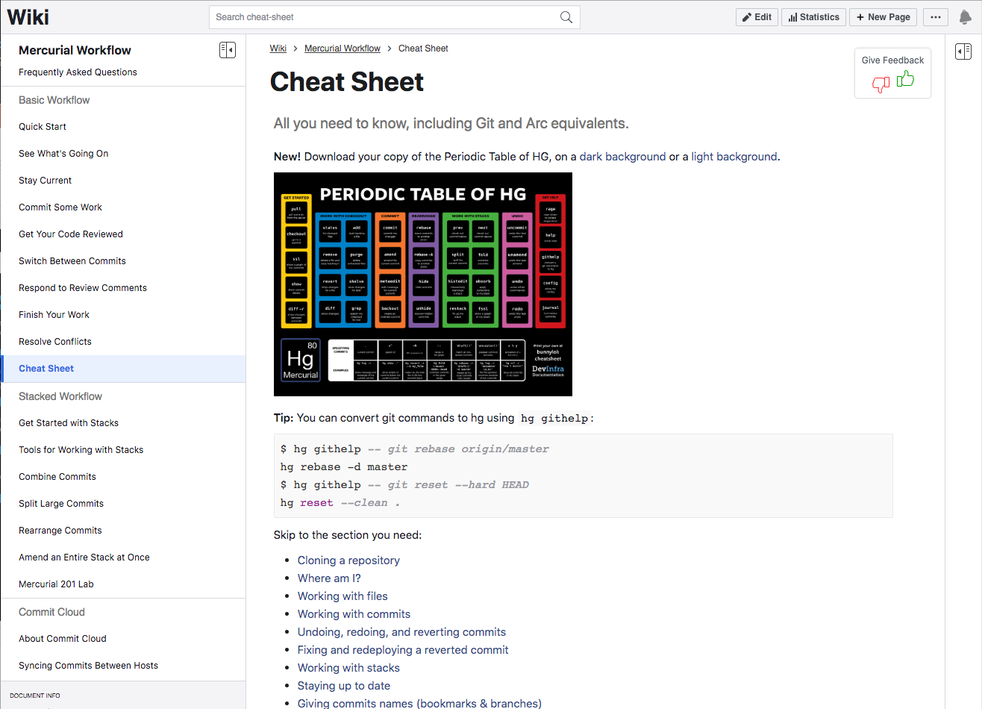

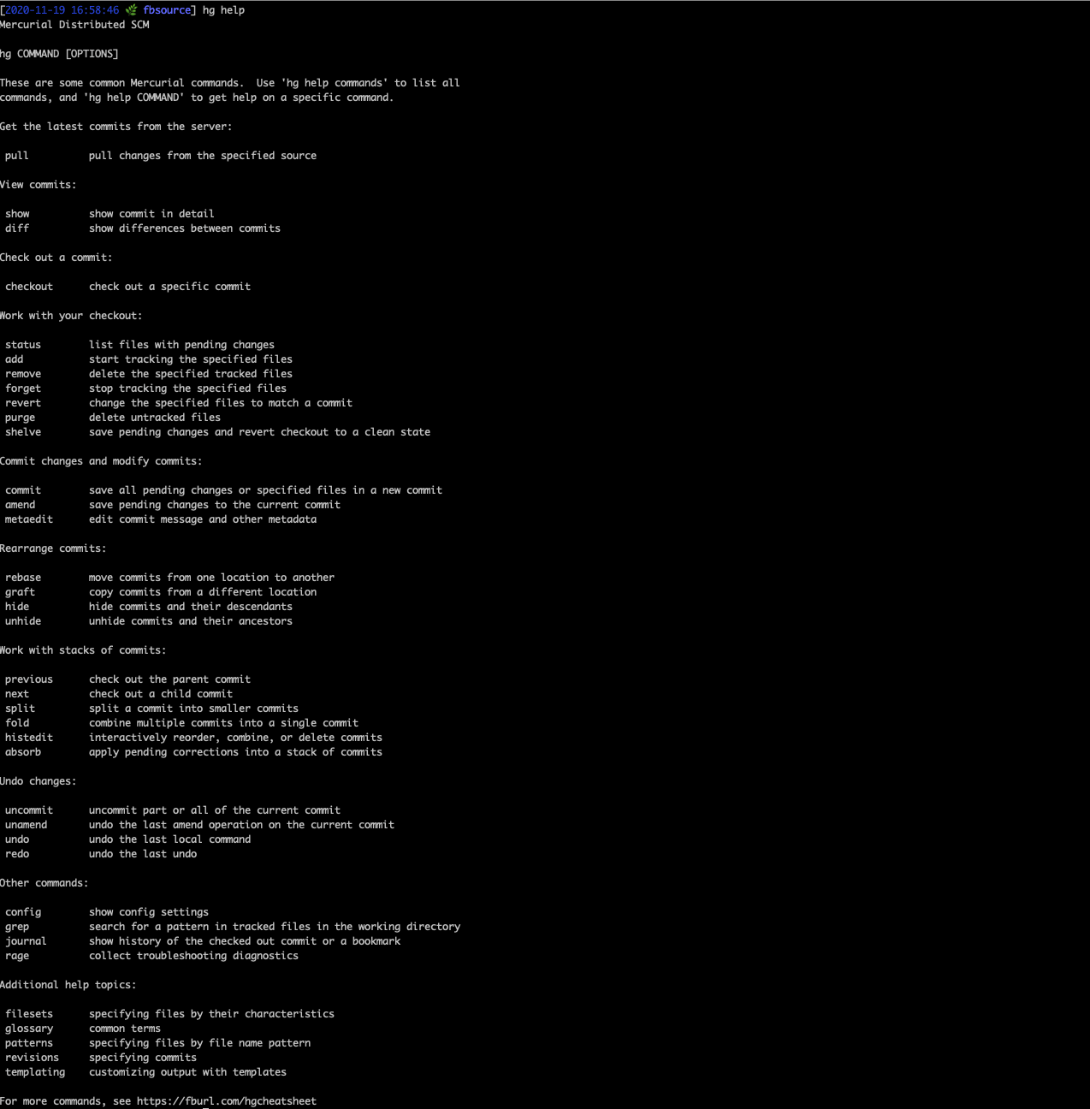
Notes:
Places you can go for help:
- Self service:
There are a couple self service places: mecurial cheatsheet

Slide 6
Review
● ○ ○ ○
Notes:
Before we get started, we’re going to review some basic Mercurial concepts.
These were already covered in the Source Control @ FB Bootcamp class, but since it’s probably been a while for a lot of you, let’s refresh everyone’s memory.

Slide 7
Repository
A repository consists of a set of files along with records of the history of those files
Also sometimes referred to as a checkout and in the EdenFS world a mount
Consists of two parts:
A .hg directory – owned by Mercurial; contains all of the repo’s history and metadata
The working copy – all of the files that are part of the repo
Mercurial is a Distributed VCS – both the client and server have a complete copy of the repo
This isn’t entirely true at Facebook, but the conceptual model remains the same

Slide 8
Working Copy
The working copy consists of all of the files in the repo outside of the .hg directory
Can be thought of as a snapshot of the state of the repo as of a particular commit
The “current” commit is called the working copy parent
You can move to a different commit with hg checkout (alias for hg update)

Slide 9
EdenFS
EdenFS is a virtual filesystem that represents the working copy
File content is populated lazily
makes are monorepo continue to be feasible
multiple working copies and reclone are cheap
makes mercurial commands fast, but can slow down builds when the builds need big swaths of the repo
Requires a network connection
Default for everything except some laptop work and www.
Notes:
Meantion why eden is slow for compilings
Mega repo motivation – explain monorepo and current state
Explain watchman recwal -> switch to eden

Slide 10
EdenFS
Currently available on devservers for fbsource, ovrsource, configerator, and opsfiles
fbclone will automatically use EdenFS if available
Support for other repos (like www) is coming soon!
Windows and Mac support is currently in beta, try it out with fbclone --eden
Notes:
Meantion why eden is slow for compilings
Link eden group/wiki here – maybe split
Mega repo motivation
Eden commands
Eden du
Eden list
Eden gc

Slide 11
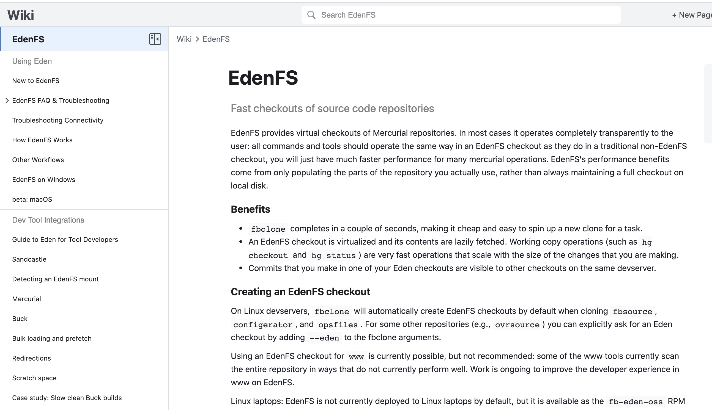

EdenFS
Top EdenFS commands to know:
eden restart --graceful
eden doctor
eden du --clean
See eden --help for more!
Notes:
Meantion why eden is slow for compilings
Link eden group/wiki here – maybe split
Mega repo motivation
Eden commands
Eden du
Eden list
Eden gc

Slide 12
Commit
A commit is a set of saved changes
In Mercurial, sometimes called a changeset or a revision
Uniquely identified by a 40 character hexadecimal hash (or a unique prefix thereof)
You can view a commit with hg show
$ hg show 785496568f
changeset: 785496568f2d8e6bb92469794ab61953ffdc5b19 D4753646
bookmarks: firstwebpage
parent: 1642008:add2efac3af6
user: Arun Kulshreshtha kulshrax@fb.com
date: Wed, 22 Mar 2017 05:25:35 -0700
Added First Webpage Controller
Differential Revision: https://phabricator.intern.facebook.com/D4753646

Slide 13
Bookmarks
A bookmark is a pointer to a commit
Bookmarks can be local or remote
Local bookmarks are local to your machine only – no one else can see them or interact with them
Remote bookmarks are owned by the server – only the server can modify them
remote/master is a remote bookmark that points to the latest commit on the server
Visit https://fburl.com/mercurial_bookmarks to learn more about creating and managing local bookmarks
$ hg bookmarks -all
debug 629ac0ddc653
logging ed8e3b6c9a14
my_bookmark 5b6596867045
remote/master 2697f8e4bc80
Notes:
Bookmarks are like branches but
Note that bookmarks are light weight, not like git branch’s

Slide 14
Smartlog
$ hg sl
o 5b65968 kulshrax D4765741 t16343212 my_bookmark
/ This is not the current commit
|
| @ 8a642a kulshrax
|/ This is the current commit
|
o 6416033 tungpham D4745018 t16127264 remote/master
. [messenger][RC] Fix bug: Action sheet isn't closed after tapping on "Send”
.
| o ed8e3b kulshrax D4681012 t15684568 logging
| | Update logging to include debug output
| |
| o 629ac0 kulshrax D4685939 t15684568 debug
|/ Add debug flag to system for testing purposes
|
o 4a4d87 aeckert D4738514 t16780035
| [easy][disruptive-upgrade] pass in user to build_transaction_history
~
Notes:
Make slide defining decendent and ancestor

Slide 15
Super-Smartlog
$ hg ssl
o 5b65968 kulshrax D4765741 Needs Review t16343212 my_bookmark
/ This is not the current commit
|
| @ 8a642a kulshrax
|/ This is the current commit
|
o 6416033 tungpham D4745018 Committed t16127264 remote/master
. [messenger][RC] Fix bug: Action sheet isn't closed after tapping on "Send”
.
| o ed8e3b kulshrax D4681012 Accepted t15684568 logging
| | Update logging to include debug output
| |
| o 629ac0 kulshrax D4685939 Needs Revision t15684568 debug
|/ Add debug flag to system for testing purposes
|
o 4a4d87 aeckert D4738514 Committed t16780035
| [easy][disruptive-upgrade] pass in user to build_transaction_history
~

Slide 16
Specifying Commits
○ ● ○ ○

Slide 17
Revsets
Revsets are a query language for commits
Any command that accepts commit hashes also accepts revsets
hg log –r <revset>
hg rebase –d master –r <revset>
hg hide <revset>
Notes:
“Revsets” is a query language built into Mercurial. It allows you to select commits in a wide variety of ways.
We’re going over this first because we’ll be using revsets throughout the examples in this slide deck.
Note: for revset examples, we use it in smart log,

Slide 18
Revsets
$ hg sl
o 0520bf durham D4922286 t17520818 remote/master
. [some_project] Some commit
.
| o 61a9ea kulshrax
| | Commit 6
| |
| o bc5334 kulshrax my_bookmark
| | Commit 5
| |
| | o 853b21 kulshrax
| | | Commit 4
| | |
| | @ f0d333 kulshrax active_bookmark*
| |/ Commit 3
| |
| o 0506f2 kulshrax
| | Commit 2
| |
| o 5d21272 kulshrax another_bookmark
|/ Commit 1
|
o 1f6146 shuyewu D4931892
| [EFT] Delete getViewerReaction
~
hg sl –r .
. refers to the current commit

Slide 19
Revsets
$ hg sl
o 0520bf durham D4922286 t17520818 remote/master
. [some_project] Some commit
.
| o 61a9ea kulshrax
| | Commit 6
| |
| o bc5334 kulshrax my_bookmark
| | Commit 5
| |
| | o 853b21 kulshrax
| | | Commit 4
| | |
| | @ f0d333 kulshrax active_bookmark*
| |/ Commit 3
| |
| o 0506f2 kulshrax
| | Commit 2
| |
| o 5d21272 kulshrax another_bookmark
|/ Commit 1
|
o 1f6146 shuyewu D4931892
| [EFT] Delete getViewerReaction
~
hg sl –r .
. refers to the current commit

Slide 20
Revsets
$ hg sl
o 0520bf durham D4922286 t17520818 remote/master
. [some_project] Some commit
.
| o 61a9ea kulshrax
| | Commit 6
| |
| o bc5334 kulshrax my_bookmark
| | Commit 5
| |
| | o 853b21 kulshrax
| | | Commit 4
| | |
| | @ f0d333 kulshrax active_bookmark*
| |/ Commit 3
| |
| o 0506f2 kulshrax
| | Commit 2
| |
| o 5d21272 kulshrax another_bookmark
|/ Commit 1
|
o 1f6146 shuyewu D4931892
| [EFT] Delete getViewerReaction
~
hg sl –r .^
^ means “parent of”

Slide 21
Revsets
$ hg sl
o 0520bf durham D4922286 t17520818 remote/master
. [some_project] Some commit
.
| o 61a9ea kulshrax
| | Commit 6
| |
| o bc5334 kulshrax my_bookmark
| | Commit 5
| |
| | o 853b21 kulshrax
| | | Commit 4
| | |
| | @ f0d333 kulshrax active_bookmark*
| |/ Commit 3
| |
| o 0506f2 kulshrax
| | Commit 2
| |
| o 5d21272 kulshrax another_bookmark
|/ Commit 1
|
o 1f6146 shuyewu D4931892
| [EFT] Delete getViewerReaction
~
hg sl –r .^
^ means “parent of”

Slide 22
Revsets
$ hg sl
o 0520bf durham D4922286 t17520818 remote/master
. [some_project] Some commit
.
| o 61a9ea kulshrax
| | Commit 6
| |
| o bc5334 kulshrax my_bookmark
| | Commit 5
| |
| | o 853b21 kulshrax
| | | Commit 4
| | |
| | @ f0d333 kulshrax active_bookmark*
| |/ Commit 3
| |
| o 0506f2 kulshrax
| | Commit 2
| |
| o 5d21272 kulshrax another_bookmark
|/ Commit 1
|
o 1f6146 shuyewu D4931892
| [EFT] Delete getViewerReaction
~
hg sl –r 61a9ea^
^ means “parent of”

Slide 23
Revsets
$ hg sl
o 0520bf durham D4922286 t17520818 remote/master
. [some_project] Some commit
.
| o 61a9ea kulshrax
| | Commit 6
| |
| o bc5334 kulshrax my_bookmark
| | Commit 5
| |
| | o 853b21 kulshrax
| | | Commit 4
| | |
| | @ f0d333 kulshrax active_bookmark*
| |/ Commit 3
| |
| o 0506f2 kulshrax
| | Commit 2
| |
| o 5d21272 kulshrax another_bookmark
|/ Commit 1
|
o 1f6146 shuyewu D4931892
| [EFT] Delete getViewerReaction
~
hg sl –r 61a9ea^
^ means “parent of”

Slide 24
Revsets
$ hg sl
o 0520bf durham D4922286 t17520818 remote/master
. [some_project] Some commit
.
| o 61a9ea kulshrax
| | Commit 6
| |
| o bc5334 kulshrax my_bookmark
| | Commit 5
| |
| | o 853b21 kulshrax
| | | Commit 4
| | |
| | @ f0d333 kulshrax active_bookmark*
| |/ Commit 3
| |
| o 0506f2 kulshrax
| | Commit 2
| |
| o 5d21272 kulshrax another_bookmark
|/ Commit 1
|
o 1f6146 shuyewu D4931892
| [EFT] Delete getViewerReaction
~
hg sl –r .~2
~N means “n^{th} ancestor of”

Slide 25
Revsets
$ hg sl
o 0520bf durham D4922286 t17520818 remote/master
. [some_project] Some commit
.
| o 61a9ea kulshrax
| | Commit 6
| |
| o bc5334 kulshrax my_bookmark
| | Commit 5
| |
| | o 853b21 kulshrax
| | | Commit 4
| | |
| | @ f0d333 kulshrax active_bookmark*
| |/ Commit 3
| |
| o 0506f2 kulshrax
| | Commit 2
| |
| o 5d21272 kulshrax another_bookmark
|/ Commit 1
|
o 1f6146 shuyewu D4931892
| [EFT] Delete getViewerReaction
~
hg sl –r .~2
~N means “n^{th} ancestor of”

Slide 26
Revsets
$ hg sl
o 0520bf durham D4922286 t17520818 remote/master
. [some_project] Some commit
.
| o 61a9ea kulshrax
| | Commit 6
| |
| o bc5334 kulshrax my_bookmark
| | Commit 5
| |
| | o 853b21 kulshrax
| | | Commit 4
| | |
| | @ f0d333 kulshrax active_bookmark*
| |/ Commit 3
| |
| o 0506f2 kulshrax
| | Commit 2
| |
| o 5d21272 kulshrax another_bookmark
|/ Commit 1
|
o 1f6146 shuyewu D4931892
| [EFT] Delete getViewerReaction
~
hg sl –r 0506f2::61a9ea
:: denotes a range in the graph

Slide 27
Revsets
$ hg sl
o 0520bf durham D4922286 t17520818 remote/master
. [some_project] Some commit
.
| o 61a9ea kulshrax
| | Commit 6
| |
| o bc5334 kulshrax my_bookmark
| | Commit 5
| |
| | o 853b21 kulshrax
| | | Commit 4
| | |
| | @ f0d333 kulshrax active_bookmark*
| |/ Commit 3
| |
| o 0506f2 kulshrax
| | Commit 2
| |
| o 5d21272 kulshrax another_bookmark
|/ Commit 1
|
o 1f6146 shuyewu D4931892
| [EFT] Delete getViewerReaction
~
hg sl –r 0506f2::61a9ea
:: denotes a range in the graph

Slide 28
Revsets
$ hg sl
o 0520bf durham D4922286 t17520818 remote/master
. [some_project] Some commit
.
| o 61a9ea kulshrax
| | Commit 6
| |
| o bc5334 kulshrax my_bookmark
| | Commit 5
| |
| | o 853b21 kulshrax
| | | Commit 4
| | |
| | @ f0d333 kulshrax active_bookmark*
| |/ Commit 3
| |
| o 0506f2 kulshrax
| | Commit 2
| |
| o 5d21272 kulshrax another_bookmark
|/ Commit 1
|
o 1f6146 shuyewu D4931892
| [EFT] Delete getViewerReaction
~
hg sl –r ::61a9ea
:: denotes a range in the graph
Can leave off either end

Slide 29
Revsets
$ hg sl
o 0520bf durham D4922286 t17520818 remote/master
. [some_project] Some commit
.
| o 61a9ea kulshrax
| | Commit 6
| |
| o bc5334 kulshrax my_bookmark
| | Commit 5
| |
| | o 853b21 kulshrax
| | | Commit 4
| | |
| | @ f0d333 kulshrax active_bookmark*
| |/ Commit 3
| |
| o 0506f2 kulshrax
| | Commit 2
| |
| o 5d21272 kulshrax another_bookmark
|/ Commit 1
|
o 1f6146 shuyewu D4931892
| [EFT] Delete getViewerReaction
~
hg sl –r 0506f2::
:: denotes a range in the graph
Can leave off either end

Slide 30
Revsets
$ hg sl
o 0520bf durham D4922286 t17520818 remote/master
. [some_project] Some commit
.
| o 61a9ea kulshrax
| | Commit 6
| |
| o bc5334 kulshrax my_bookmark
| | Commit 5
| |
| | o 853b21 kulshrax
| | | Commit 4
| | |
| | @ f0d333 kulshrax active_bookmark*
| |/ Commit 3
| |
| o 0506f2 kulshrax
| | Commit 2
| |
| o 5d21272 kulshrax another_bookmark
|/ Commit 1
|
o 1f6146 shuyewu D4931892
| [EFT] Delete getViewerReaction
~
hg sl –r 'draft()'
draft() is a “revset predicate”
Matches all non-landed commits

Slide 31
Revsets
$ hg sl
o 0520bf durham D4922286 t17520818 remote/master
. [some_project] Some commit
.
| o 61a9ea kulshrax
| | Commit 6
| |
| o bc5334 kulshrax my_bookmark
| | Commit 5
| |
| | o 853b21 kulshrax
| | | Commit 4
| | |
| | @ f0d333 kulshrax active_bookmark*
| |/ Commit 3
| |
| o 0506f2 kulshrax
| | Commit 2
| |
| o 5d21272 kulshrax another_bookmark
|/ Commit 1
|
o 1f6146 shuyewu D4931892
| [EFT] Delete getViewerReaction
~
hg sl –r 'draft()'
draft() is a “revset predicate”
Matches all non-landed commits

Slide 32
Revsets
$ hg sl
o 0520bf durham D4922286 t17520818 remote/master
. [some_project] Some commit
.
| o 61a9ea kulshrax
| | Commit 6
| |
| o bc5334 kulshrax my_bookmark
| | Commit 5
| |
| | o 853b21 kulshrax
| | | Commit 4
| | |
| | @ f0d333 kulshrax active_bookmark*
| |/ Commit 3
| |
| o 0506f2 kulshrax
| | Commit 2
| |
| o 5d21272 kulshrax another_bookmark
|/ Commit 1
|
o 1f6146 shuyewu D4931892
| [EFT] Delete getViewerReaction
~
hg sl –r 'draft()'
draft() is a “revset predicate”
Matches all non-landed commits
Example:
hg rebase –d master –r 'draft()'

Slide 33
Revsets
$ hg sl
o 0520bf durham D4922286 t17520818 remote/master
. [some_project] Some commit
.
| o 61a9ea kulshrax
| | Commit 6
| |
| o bc5334 kulshrax my_bookmark
| | Commit 5
| |
| | o 853b21 kulshrax
| | | Commit 4
| | |
| | @ f0d333 kulshrax active_bookmark*
| |/ Commit 3
| |
| o 0506f2 kulshrax
| | Commit 2
| |
| o 5d21272 kulshrax another_bookmark
|/ Commit 1
|
o 1f6146 shuyewu D4931892
| [EFT] Delete getViewerReaction
~
hg sl –r 'public()'
Matches all landed commits

Slide 34
Revsets
$ hg sl
o 0520bf durham D4922286 t17520818 remote/master
. [some_project] Some commit
.
| o 61a9ea kulshrax
| | Commit 6
| |
| o bc5334 kulshrax my_bookmark
| | Commit 5
| |
| | o 853b21 kulshrax
| | | Commit 4
| | |
| | @ f0d333 kulshrax active_bookmark*
| |/ Commit 3
| |
| o 0506f2 kulshrax
| | Commit 2
| |
| o 5d21272 kulshrax another_bookmark
|/ Commit 1
|
o 1f6146 shuyewu D4931892
| [EFT] Delete getViewerReaction
~
hg sl –r 'public()'
Matches all landed commits

Slide 35
Revsets
$ hg sl
o 0520bf durham D4922286 t17520818 remote/master
. [some_project] Some commit
.
| o 61a9ea kulshrax
| | Commit 6
| |
| o bc5334 kulshrax my_bookmark
| | Commit 5
| |
| | o 853b21 kulshrax
| | | Commit 4
| | |
| | @ f0d333 kulshrax active_bookmark*
| |/ Commit 3
| |
| o 0506f2 kulshrax
| | Commit 2
| |
| o 5d21272 kulshrax another_bookmark
|/ Commit 1
|
o 1f6146 shuyewu D4931892
| [EFT] Delete getViewerReaction
~
hg sl –r 'draft() – .::'
Revsets support set operators:
+ Union
& Intersection
- Difference

Slide 36
Revsets
$ hg sl
o 0520bf durham D4922286 t17520818 remote/master
. [some_project] Some commit
.
| o 61a9ea kulshrax
| | Commit 6
| |
| o bc5334 kulshrax my_bookmark
| | Commit 5
| |
| | o 853b21 kulshrax
| | | Commit 4
| | |
| | @ f0d333 kulshrax active_bookmark*
| |/ Commit 3
| |
| o 0506f2 kulshrax
| | Commit 2
| |
| o 5d21272 kulshrax another_bookmark
|/ Commit 1
|
o 1f6146 shuyewu D4931892
| [EFT] Delete getViewerReaction
~
hg sl –r 'draft() – .::'
Revsets support set operators:
+ Union
& Intersection
- Difference

Slide 37
Revsets
Check out Mercurial wiki for more information
hg help revsets
https://www.mercurial-scm.org/repo/hg/help/revsets (doesn't include extension revsets)

Slide 38
break

Slide 39
Undoing Things
○ ○ ● ○

Slide 40
Older and Newer Versions
Commands like hg amend create new versions of commits
Old versions of commits are usually hidden
Mercurial tracks the rewrite history of commits
Notes:
Commands like hg amend, rebase, split, fold, histedit, and anything else that rewrites history doesn’t actually alter existing commits.
Instead, these commands make new commits and hide the old ones.
Mercurial tracks the relationship between old and new versions of commits. This information can be used to undo history editing commands.
Don’t mention Obsolesence markers that’s just confusing terminology

Slide 41
Older and Newer Versions
Can use revsets to see all older or newer versions:
predecessors(MY_COMMIT)
successors(MY_COMMIT)
Example: hg log -r ‘predecessors(.)’ --hidden
Can limit the number of steps traversed with:
predecessors(MY_COMMIT, MAX_DEPTH)
successors(MY_COMMIT, MAX_DEPTH)
Notes:
These revsets allow you to query for older or newer versions of the given commit.
The predecessors() revset gives all older versions, while successors() gives all newer versions. Both include the original commit – this is analogous to ancestors() and descendants.
Like ancestors() and descendants(), both accept a second argument to limit the search depth. To get immediate predecessors of X use ‘predecessors(X,1) – X’

Slide 42
Not to be confused with
Ancestors: commits this commit is stacked on
Descendants: commits that are stacked on this commit
predecessors and successors are different versions of the same commit. Ancestors and Descendants are different commits.
Notes:
These revsets allow you to query for older or newer versions of the given commit.
The predecessors() revset gives all older versions, while successors() gives all newer versions. Both include the original commit – this is analogous to ancestors() and descendants.
Like ancestors() and descendants(), both accept a second argument to limit the search depth. To get immediate predecessors of X use ‘predecessors(X,1) – X’

Slide 43
Hidden Commits
$ hg sl
o 2803df kulshrax
| Stacked commit 3
|
@ 497cd6 kulshrax
| Stacked commit 2
|
o 1bd4b8 kulshrax
| Stacked commit 1
~
$ hg sl --hidden
o 2803df kulshrax
| Stacked commit 3
|
@ 497cd6 kulshrax
| Stacked commit 2
|
| x 959741 (Rebased as 2803df) kulshrax
| | Stacked commit 3
| |
| x fb84c3 (Amended as 497cd6) kulshrax
|/ Stacked commit 2
|
o 1bd4b8 kulshrax
| Stacked commit 1
~
Notes:
Ordinarily, you can’t see hidden commits (unless there is a problem with your stack that would require hg restack).
You can pass the --hidden flag to any hg command to make hidden commits ‘visible’.
For example, you can use hg sl --hidden to see hidden older versions of the commits in your stack.
Note that in smartlog, you can see the relationship between hidden commits and their newer versions.

Slide 44
Hiding Commits
$ hg sl
o a8398c9 kulshrax my_bookmark
| Stacked commit 5
|
@ 1435ea kulshrax
| Stacked commit 4
|
o ff2f576 kulshrax
| Stacked commit 3
|
o e7440d kulshrax
| Stacked commit 2
|
o 5b65968 kulshrax
/ Stacked commit 1
|
o 4a4d87 aeckert D4738514 t16780035 remote/master
| [some_project] Some commit
~
hg hide hides commits
Does not delete commit
Hides all descendants of the specified commits
Thus, these are equivalent:
hg hide ff2f576
hg hide ff2f576::
Notes:
At Facebook, we’ve configured hg strip to hide commits instead of deleting them.
Disregard the help text for the command that says that the commits are deleted and moved to a backup bundle – they’re actually just hidden and left in the repo.
You can update back to the hash of a stripped commit and it will be unhidden.
For getting those garbage commits out of there

Slide 45
Hiding Commits
$ hg hide .
0 files updated, 0 files merged, 2 files removed,
0 files unresolved
working directory now at ff2f57637080f
2 commits pruned
$ hg sl
o a8398c9 kulshrax my_bookmark
| Stacked commit 5
|
@ 1435ea kulshrax
| Stacked commit 4
|
o ff2f576 kulshrax
| Stacked commit 3
|
o e7440d kulshrax
| Stacked commit 2
|
o 5b65968 kulshrax
/ Stacked commit 1
|
o 4a4d87 aeckert D4738514 t16780035 remote/master
| [some_project] Some commit
~
hg hide hides commits
Does not delete commit
Hides all descendants of the specified commits
Thus, these are equivalent:
hg hide ff2f576
hg hide ff2f576::

Slide 46
Hiding Commits
$ hg hide .
0 files updated, 0 files merged, 2 files removed,
0 files unresolved
working directory now at ff2f57637080f
2 commits pruned
$ hg sl
@ ff2f576 kulshrax my_bookmark
| Stacked commit 3
|
o e7440d kulshrax
| Stacked commit 2
|
o 5b65968 kulshrax
/ Stacked commit 1
|
o 4a4d87 aeckert D4738514 t16780035 remote/master
| [some_project] Some commit
~
hg hide hides commits
Does not delete commit
Hides all descendants of the specified commits
Thus, these are equivalent:
hg hide ff2f576
hg hide ff2f576::
Notes:
Note that ‘hg strip .’ removed the current commit and its child.
The bookmark on its child commit was moved down – in general hg strip will move bookmarks on the stripped commits down to the first ancestors that isn’t being stripped.

Slide 47
Un-Hiding Commits
$ hg sl
@ ff2f576 kulshrax my_bookmark
| Stacked commit 3
|
o e7440d kulshrax
| Stacked commit 2
|
o 5b65968 kulshrax
/ Stacked commit 1
|
o 4a4d87 aeckert D4738514 t16780035 remote/master
| [some_project] Some commit
~
Hidden commits are still in the repo
If you remember the hash, you can
hg checkout a hidden commit
It will be temporarily un-hidden, along with its ancestors

Slide 48
Un-Hiding Commits
$ hg sl --hidden
x a8398c9 kulshrax
| Stacked commit 5
|
x 1435ea kulshrax
| Stacked commit 4
|
@ ff2f576 kulshrax my_bookmark
| Stacked commit 3
|
o e7440d kulshrax
| Stacked commit 2
|
o 5b65968 kulshrax
/ Stacked commit 1
|
o 4a4d87 aeckert D4738514 t16780035 remote/master
| [some_project] Some commit
~
Hidden commits are still in the repo
If you remember the hash, you can
hg checkout a hidden commit
It will be temporarily un-hidden, along with its ancestors

Slide 49
Un-Hiding Commits
$ hg checkout a8398c9
2 files updated, 0 files merged, 0 files removed,
0 files unresolved
$ hg sl
@ a8398c9 kulshrax
| Stacked commit 5
|
x 1435ea kulshrax
| Stacked commit 4
|
o ff2f576 kulshrax my_bookmark
| Stacked commit 3
|
o e7440d kulshrax
| Stacked commit 2
|
o 5b65968 kulshrax
/ Stacked commit 1
|
o 4a4d87 aeckert D4738514 t16780035 remote/master
| [some_project] Some commit
~
Hidden commits are still in the repo
If you remember the hash, you can
hg checkout a hidden commit
It will be temporarily un-hidden, along with its ancestors

Slide 50
Un-Hiding Commits
$ hg checkout ff2f576
2 files updated, 0 files merged, 0 files removed,
0 files unresolved
$ hg sl
@ ff2f576 kulshrax my_bookmark
| Stacked commit 3
|
o e7440d kulshrax
| Stacked commit 2
|
o 5b65968 kulshrax
/ Stacked commit 1
|
o 4a4d87 aeckert D4738514 t16780035 remote/master
| [some_project] Some commit
~
Hidden commits are still in the repo
If you remember the hash, you can
hg checkout a hidden commit
It will be temporarily un-hidden, along with its ancestors
Notes:
As soon as you move off, the commits are hidden again

Slide 51
Un-Hiding Commits
$ hg sl
@ ff2f576 kulshrax my_bookmark
| Stacked commit 3
|
o e7440d kulshrax
| Stacked commit 2
|
o 5b65968 kulshrax
/ Stacked commit 1
|
o 4a4d87 aeckert D4738514 t16780035 remote/master
| [some_project] Some commit
~
If you want to permanently bring back a commit, you can hg unhide it
Also un-hides any hidden ancestors

Slide 52
Un-Hiding Commits
$ hg sl --hidden
x a8398c9 kulshrax
| Stacked commit 5
|
x 1435ea kulshrax
| Stacked commit 4
|
@ ff2f576 kulshrax my_bookmark
| Stacked commit 3
|
o e7440d kulshrax
| Stacked commit 2
|
o 5b65968 kulshrax
/ Stacked commit 1
|
o 4a4d87 aeckert D4738514 t16780035 remote/master
| [some_project] Some commit
~
If you want to permanently bring back a commit, you can hg unhide it
Also un-hides any hidden ancestors

Slide 53
Un-Hiding Commits
$ hg unhide a8398c9
2 files updated, 0 files merged, 0 files removed,
0 files unresolved
$ hg sl
o a8398c9 kulshrax
| Stacked commit 5
|
o 1435ea kulshrax
| Stacked commit 4
|
@ ff2f576 kulshrax my_bookmark
| Stacked commit 3
|
o e7440d kulshrax
| Stacked commit 2
|
o 5b65968 kulshrax
/ Stacked commit 1
|
o 4a4d87 aeckert D4738514 t16780035 remote/master
| [some_project] Some commit
~
If you want to permanently bring back a commit, you can hg unhide it
Also un-hides any hidden ancestors

Slide 54
Viewing Command History
$ hg journal
previous locations of '.':
b6a29511bdcb -> 7d54f85df46f kulshrax 2017-07-10 16:06 -0700 commit -m 'Make another commit'
8a9907276ed1 -> b6a29511bdcb kulshrax 2017-07-10 16:05 -0700 up some_bookmark
edc7cdba5f93 -> 8a9907276ed1 kulshrax 2017-07-10 16:05 -0700 up master
b7d9e8edb23f -> edc7cdba5f93 kulshrax 2017-07-10 16:04 -0700 rebase -r .+smc -d master
a31fb849f140 -> b7d9e8edb23f kulshrax 2017-07-10 10:58 -0700 commit -m 'Make a commit'
7ce79310d6c3 -> a31fb849f140 kulshrax 2017-07-07 13:01 -0700 up master
ee3647c46f6c -> 7ce79310d6c3 kulshrax 2017-07-07 13:01 -0700 rebase -d master
ea28c3fdae9f,21ded4836c1f -> ee3647c46f6c kulshrax 2017-07-07 12:47 -0700 rebase --abort
ee3647c46f6c -> ea28c3fdae9f,21ded4836c1f kulshrax 2017-07-07 12:46 -0700 rebaseall -d master
81c8213cf1ee -> ee3647c46f6c kulshrax 2017-07-03 13:13 -0700 rebaseall -d master
a64e3186561b -> 81c8213cf1ee kulshrax 2017-07-03 13:12 -0700 amend -i
...
Notes:
hg journal (AKA hg reflog) shows the hashes of the commits that were previously the working copy parent. You can update back to any of those hashes to make them visible in your repo again. This is useful for undoing commands that modify history.
The hashes correspond to the working copy parent AFTER the given command was run.
Note the long rebase command next to hash b0655d0e158c. This command was run by Arcanist. Commands run by tools like Nuclide and Arcanist show up in journal, and may make it harder to read.
Also note the amend --rebase followed by an unamend and an absorb. This is an example of doing the wrong thing, undoing, and doing the right thing.
Only works with . And bookmarks

Slide 55
Viewing Command History
$ hg journal my_bookmark
previous locations of 'my_bookmark':
a878b1881ceb -> aa27e1867841 kulshrax 2017-09-27 11:46 -0700 restack
b05ddcc64514 -> a878b1881ceb kulshrax 2017-09-26 16:12 -0700 metaedit
8fa04feec26c -> b05ddcc64514 kulshrax 2017-09-26 16:11 -0700 absorb
a1ea088ccd30 -> 1278fdd88b75 kulshrax 2017-09-26 16:10 -0700 unamend
3bfbf1413d55 -> 8fa04feec26c kulshrax 2017-09-26 16:09 -0700 amend
19df6bb42761 -> 3bfbf1413d55 kulshrax 2017-09-26 16:08 -0700 rebase -s 19df6bb -d .
1278fdd88b75 -> 19df6bb42761 kulshrax 2017-09-25 13:48 -0700 rebase -d master
...
Notes:
You can also view the history of a particular bookmark.

Slide 56
Undo Commands
$ hg sl
@ 8b0313 kulshrax firstwebpage*
/ Added First Webpage Controller
|
o cc9b1ea user D1234567 remote/master
| Add awesome new feature
~
$ hg status
M XInternFirstWebpageKulshraxController.php
$ hg commit -m ”Made requested changes”
$ hg sl
@ 5b2d85 kulshrax firstwebpage*
| Made requested changes
|
o 8b0313 kulshrax
/ Added First Webpage Controller
|
o cc9b1ea user D1234567 remote/master
| Add awesome new feature
~
# Uh oh, I meant to amend!
hg uncommit
Inverse of hg commit
Hides commit, checks out parent
Keeps changes in working copy
hg unamend
Inverse of hg amend
Hides commits, checks out old version
Keeps changes in working copy

Slide 57
Undo Commands
$ hg sl
@ 5b2d85 kulshrax firstwebpage*
| Made requested changes
|
o 8b0313 kulshrax
/ Added First Webpage Controller
|
o cc9b1ea user D1234567 remote/master
| Add awesome new feature
~
$ hg status
$ hg uncommit
$ hg sl
@ 8b0313 kulshrax firstwebpage*
/ Added First Webpage Controller
|
o cc9b1ea user D1234567 remote/master
| Add awesome new feature
~
$ hg status
M XInternFirstWebpageKulshraxController.php
$ hg amend
# Phew, that’s better!
hg uncommit
Inverse of hg commit
Hides commit, checks out parent
Keeps changes in working copy
hg unamend
Inverse of hg amend
Hides commits, checks out old version
Keeps changes in working copy
Notes:
Motivation of coming from the git world and over zealously commiting

Slide 58
hg undo
hg undo undoes almost any local Mercurial operation!
hg redo undoes hg undo
hg undo -i lets you step back in time with smartlog
See fburl.com/hgundo for details!
Notes:
Note that undo doesn’t leave the working copy the same for unamend and uncommit
Can also unamend and uncommit from long ago

Slide 59
Cleaning Up
$ hg status
A fbobjc/face
R fbobjc/book
! fbobjc/this/file/is/missing
! fbobjc/where/did/it/go
? xplat/where/did/this/come/from
? xplat/i/just/dont/know
$ hg checkout --clean .
3 files updated, 0 files merged, 0 files removed,
0 files unresolved
$ hg status
? fbobjc/face
? xplat/where/did/this/come/from
? xplat/i/just/dont/know
$ hg purge
$ hg status
# No output
hg checkout --clean .
Discards any pending changes
Does not affect unknown files
Similar to hg revert --all
hg purge
Deletes all unknown files
Warning: These can’t be undone!
Notes:
These are probably the commands you want to use if you just want to throw away your changes and go back to a known good state.
You should prefer to use these when possible over the commands on the next slide; they’re more likely to actually do what you want.
Motivation of interrupting a checkout
Note control c is usually ok should cuase “clean” shutdown

Slide 60
Other Undo Commands
hg revert -r HASH filename ...
Updates the file in the working copy to the file in the specified commit
Default is currently checked out commit
You will see pending changes; committing them will undo all commits after the specified one
hg backout -r HASH
Creates an “inverse” commit that undoes the changes from the specified commit
You will see pending changes; committing them will undo just that one commit
hg reset HASH
Moves working copy parent to specified commit without changing the working copy
As a result, all changes since that commit will appear as pending changes
Notes:
These commands all have names that sound like ”undo” – it can be confusing to remember the differences between them and when to use them.

Slide 61

Revert
Line 1
Line 2
Line 3
+Line 4
@
Commit D
file1
Working Copy
$hg revert –r commitA file1
Working Copy
Line 1
Line 2
+Line 3
Commit C
Line 1
Line 2
Line 3
Line 4
Line 1
--Line 2
--Line 3
--Line 4
file1
Line 1
+Line 2
Commit B
file1
file1
+Line 1
Commit A
file1
Notes:
These commands all have names that sound like ”undo” – it can be confusing to remember the differences between them and when to use them.

Slide 62
Other Undo Commands
hg revert -r HASH filename ...
Updates the file in the working copy to the file in the specified commit
Default is currently checked out commit
You will see pending changes; committing them will undo all commits after the specified one
hg backout -r HASH
Creates an “inverse” commit that undoes the changes from the specified commit
You will see pending changes; committing them will undo just that one commit
hg reset HASH
Moves working copy parent to specified commit without changing the working copy
As a result, all changes since that commit will appear as pending changes
Notes:
These commands all have names that sound like ”undo” – it can be confusing to remember the differences between them and when to use them.

Slide 63
Backout
Line 1
Line 2
Line 3
+Line 4
@
Commit D
file1
Working Copy
$hg backout –r CommitA
Working Copy
Line 1
Line 2
+Line 3
Commit C
Line 1
Line 2
Line 3
Line 4
-Line1
Line 2
Line 3
Line4
file1
Line 1
+Line 2
Commit B
file1
file1
+Line 1
Commit A
file1
Notes:
These commands all have names that sound like ”undo” – it can be confusing to remember the differences between them and when to use them.

Slide 64
Other Undo Commands
hg revert -r HASH filename ...
Updates the file in the working copy to the file in the specified commit
Default is currently checked out commit
You will see pending changes; committing them will undo all commits after the specified one
hg backout -r HASH
Creates an “inverse” commit that undoes the changes from the specified commit
You will see pending changes; committing them will undo just that one commit
hg reset HASH
Moves working copy parent to specified commit without changing the working copy
As a result, all changes since that commit will appear as pending changes
Notes:
These commands all have names that sound like ”undo” – it can be confusing to remember the differences between them and when to use them.

Slide 65
Reset
Line 1
Line 2
Line 3
Line 4
@
Commit D
x
Commit D
file1
Working Copy
$hg reset–r CommitA
Working Copy
Line 1
Line 2
Line 3
Commit C
Line 1
Line 2
Line 3
Line 4
x
Line1
+Line 2
+Line 3
+Line 4
Commit C
file1
Line 1
Line 2
Commit B
file1
x
file1
Commit B
file1
Line 1
Commit A
@
Commit A
file1
Notes:
These commands all have names that sound like ”undo” – it can be confusing to remember the differences between them and when to use them.

Slide 66
Commit Cloud
⛅️ Commit Cloud is a system that backs up commits to the cloud
Get started with hg cloud join (run automatically with fbclone)
Commits (and bookmarks) automatically synced across machines
Use hg cloud sync to force a sync
See fburl.com/commitcloud for details!
Note: Commit Cloud was previously known as “InfinitePush”
Notes:
Every time you create a commit (or run commands that make new commits such as amend, rebase, etc), a background process uploads them automatically to Everstore. No more losing work due to once-a-day backups.

Slide 67
⛅️ Commit Cloud Sync
“Dropbox for your commits”
Smartlog will always match across all machines
Use hg cloud sl -u unixname to see other people’s smartlogs
Download any local commit with hg checkout HASH
Can use this to share commits with others – just tell them the hash!
Learn more at fburl.com/commitcloudsync!

Slide 68
Stacked Commits
○ ○ ○ ●

Slide 69
Stack Navigation
$ hg fsl
@ a8398c9 kulshrax my_bookmark*
| Stacked commit 5
|
o 1435ea kulshrax
| Stacked commit 4
|
o ff2f576 kulshrax
| Stacked commit 3
|
o e7440d kulshrax another_bookmark
| Stacked commit 2
|
o 5b65968 kulshrax
/ Stacked commit 1
|
o 4a4d87 aeckert D4738514 t16780035 remote/master
| [some_project] Some commit
~
Move up and down your stack with hg prev and hg next
Can optionally specify the number of commits to move
Lots of useful flags:
--top
--bottom
--clean
--merge
--rebase
--bookmark
--towards

Slide 70
Stack Navigation
$ hg prev 3
0 files updated, 0 files merged, 2 files removed,
0 files unresolved
[e7440d] (another_bookmark) Stacked commit 1
(activating bookmark another_bookmark)
$ hg fsl
@ a8398c9 kulshrax my_bookmark*
| Stacked commit 5
|
o 1435ea kulshrax
| Stacked commit 4
|
o ff2f576 kulshrax
| Stacked commit 3
|
o e7440d kulshrax another_bookmark
| Stacked commit 2
|
o 5b65968 kulshrax
/ Stacked commit 1
|
o 4a4d87 aeckert D4738514 t16780035 remote/master
| [some_project] Some commit
~
Move up and down your stack with hg prev and hg next
Can optionally specify the number of commits to move
Lots of useful flags:
--top
--bottom
--clean
--merge
--rebase
--bookmark
--towards
--newest

Slide 71
Stack Navigation
$ hg prev 3
0 files updated, 0 files merged, 2 files removed,
0 files unresolved
[e7440d] (another_bookmark) Stacked commit 1
(activating bookmark another_bookmark)
$ hg fsl
o a8398c9 kulshrax my_bookmark
| Stacked commit 5
|
o 1435ea kulshrax
| Stacked commit 4
|
o ff2f576 kulshrax
| Stacked commit 3
|
@ e7440d kulshrax another_bookmark*
| Stacked commit 2
|
o 5b65968 kulshrax
/ Stacked commit 1
|
o 4a4d87 aeckert D4738514 t16780035 remote/master
| [some_project] Some commit
~
Move up and down your stack with hg prev and hg next
Can optionally specify the number of commits to move
Lots of useful flags:
--top
--bottom
--clean
--merge
--rebase
--bookmark
--towards

Slide 72
Moving Commits
$ hg sl
o 0520bf durham D4922286 t17520818 remote/master
. [some_project] Some commit
.
| o 61a9ea kulshrax
| | Commit 6
| |
| o bc5334 kulshrax
| | Commit 5
| |
| | o 853b21 kulshrax
| | | Commit 4
| | |
| | @ f0d333 kulshrax
| |/ Commit 3
| |
| o 0506f2 kulshrax
| | Commit 2
| |
| o 5521272 kulshrax
|/ Commit 1
|
o 1f6146 shuyewu D4931892
| [EFT] Delete getViewerReaction
~
hg rebase moves commits around
What to move:
-r --rev Exact match only
-s --source Includes descendants
-b --base Includes entire subtree
Where to move it:
-d --dest
Keep old commits?
-k --keep

Slide 73
Moving Commits
$ hg sl
o 0520bf durham D4922286 t17520818 remote/master
. [some_project] Some commit
.
| o 61a9ea kulshrax
| | Commit 6
| |
| o bc5334 kulshrax
| | Commit 5
| |
| | o 853b21 kulshrax
| | | Commit 4
| | |
| | @ f0d333 kulshrax
| |/ Commit 3
| |
| o 0506f2 kulshrax
| | Commit 2
| |
| o 5521272 kulshrax
|/ Commit 1
|
o 1f6146 shuyewu D4931892
| [EFT] Delete getViewerReaction
~
$ hg rebase –d master –r .
hg rebase moves commits around
What to move:
-r --rev Exact match only
-s --source Includes descendants
-b --base Includes entire subtree
Where to move it:
-d --dest
Keep old commits?
-k --keep

Slide 74
Moving Commits
$ hg sl
o 0520bf durham D4922286 t17520818 remote/master
. [some_project] Some commit
.
| o 61a9ea kulshrax
| | Commit 6
| |
| o bc5334 kulshrax
| | Commit 5
| |
| | o 853b21 kulshrax
| | | Commit 4
| | |
| | @ f0d333 kulshrax
| |/ Commit 3
| |
| o 0506f2 kulshrax
| | Commit 2
| |
| o 5521272 kulshrax
|/ Commit 1
|
o 1f6146 shuyewu D4931892
| [EFT] Delete getViewerReaction
~
$ hg rebase –d master –r .
hg rebase moves commits around
What to move:
-r --rev Exact match only
-s --source Includes descendants
-b --base Includes entire subtree
Where to move it:
-d --dest
Keep old commits?
-k --keep

Slide 75
Moving Commits
$ hg sl
o 0520bf durham D4922286 t17520818 remote/master
. [some_project] Some commit
.
| o 61a9ea kulshrax
| | Commit 6
| |
| o bc5334 kulshrax
| | Commit 5
| |
| | o 853b21 kulshrax
| | | Commit 4
| | |
| | @ f0d333 kulshrax
| |/ Commit 3
| |
| o 0506f2 kulshrax
| | Commit 2
| |
| o 5521272 kulshrax
|/ Commit 1
|
o 1f6146 shuyewu D4931892
| [EFT] Delete getViewerReaction
~
$ hg rebase –d master –s .
hg rebase moves commits around
What to move:
-r --rev Exact match only
-s --source Includes descendants
-b --base Includes entire subtree
Where to move it:
-d --dest
Keep old commits?
-k --keep

Slide 76
Moving Commits
$ hg sl
o 0520bf durham D4922286 t17520818 remote/master
. [some_project] Some commit
.
| o 61a9ea kulshrax
| | Commit 6
| |
| o bc5334 kulshrax
| | Commit 5
| |
| | o 853b21 kulshrax
| | | Commit 4
| | |
| | @ f0d333 kulshrax
| |/ Commit 3
| |
| o 0506f2 kulshrax
| | Commit 2
| |
| o 5521272 kulshrax
|/ Commit 1
|
o 1f6146 shuyewu D4931892
| [EFT] Delete getViewerReaction
~
$ hg rebase –d master –b .
hg rebase moves commits around
What to move:
-r --rev Exact match only
-s --source Includes descendants
-b --base Includes entire subtree
Where to move it:
-d --dest
Keep old commits?
-k --keep
Notes:
Say tree instead of stack for base

Slide 77
Folding Commits
$ hg sl
o a8398c9 kulshrax
| Stacked commit 5
|
@ 1435ea kulshrax
| Stacked commit 4
|
o ff2f576 kulshrax
| Stacked commit 3
|
o e7440d kulshrax
| Stacked commit 2
|
o 5b65968 kulshrax
/ Stacked commit 1
|
o 4a4d87 aeckert D4738514 t16780035 remote/master
| [some_project] Some commit
~
hg fold combines commits together
Commits must be adjacent to each other
Commit messages will be concatenated
Child commits are automatically restacked
Examples:
hg fold --from HASH
hg fold --exact HASH1 HASH2 HASH3 ...

Slide 78
Folding Commits
$ hg fold --from .~2
3 changesets folded
0 files updated, 0 files merged, 0 files removed,
0 files unresolved
rebasing 1693274:a8398c9e92a0 ”Stacked commit 5”
$ hg sl
o a8398c9 kulshrax
| Stacked commit 5
|
@ 1435ea kulshrax
| Stacked commit 4
|
o ff2f576 kulshrax
| Stacked commit 3
|
o e7440d kulshrax
| Stacked commit 2
|
o 5b65968 kulshrax
/ Stacked commit 1
|
o 4a4d87 aeckert D4738514 t16780035 remote/master
| [some_project] Some commit
~
hg fold combines commits together
Commits must be adjacent to each other
Commit messages will be concatenated
Child commits are automatically restacked
Examples:
hg fold --from HASH
hg fold --exact HASH1 HASH2 HASH3 ...

Slide 79
Folding Commits
$ hg fold --from .~2
3 changesets folded
0 files updated, 0 files merged, 0 files removed,
0 files unresolved
rebasing 1693274:a8398c9e92a0 ”Stacked commit 5”
$ hg sl
o a8398c9 kulshrax
| Stacked commit 5
|
@ 1435ea kulshrax
| Stacked commit 4
|
o ff2f576 kulshrax
| Stacked commit 3
|
o e7440d kulshrax
| Stacked commit 2
|
o 5b65968 kulshrax
/ Stacked commit 1
|
o 4a4d87 aeckert D4738514 t16780035 remote/master
| [some_project] Some commit
~
hg fold combines commits together
Commits must be adjacent to each other
Commit messages will be concatenated
Child commits are automatically restacked
Examples:
hg fold --from HASH
hg fold --exact HASH1 HASH2 HASH3 ...

Slide 80
Folding Commits
$ hg fold --from .~2
3 changesets folded
0 files updated, 0 files merged, 0 files removed,
0 files unresolved
rebasing 1693274:a8398c9e92a0 ”Stacked commit 5”
$ hg sl
o 7d2e816 kulshrax
| Stacked commit 5
|
@ 83305b2 kulshrax
| Combination of commits 2, 3, and 4
|
o 5b65968 kulshrax
/ Stacked commit 1
|
o 4a4d87 aeckert D4738514 t16780035 remote/master
| [some_project] Some commit
~
hg fold combines commits together
Commits must be adjacent to each other
Commit messages will be concatenated
Child commits are automatically restacked
Examples:
hg fold --from HASH
hg fold --exact HASH1 HASH2 HASH3 ...

Slide 81
Splitting Commits
Select hunks to record - [x]=selected **=collapsed c: confirm
q: abort arrow keys: move/expand/collapse space: deselect ?: help
[~] diff --git a/hgsubversion/util.py b/hgsubversion/util.py
3 hunks, 12 lines changed
[x]** @@ -23,6 +23,12 @@ try:
[x] @@ -345,7 +351,10 @@ def revset_fromsvn(repo, subset, x):
raise hgutil.Abort("svn metadata is missing")
svnrevs = set(rev(h) for h in meta.hashes().keys())
[x] - return filter(svnrevs.__contains__, subset)
[x] + filteredrevs = filter(svnrevs.__contains__, subset)
[x] + if smartset is not None:
[x] + filteredrevs = smartset.baseset(filteredrevs)
[x] + return filteredrevs
def revset_svnrev(repo, subset, x):
'''``svnrev(number)``
[ ] @@ -369,6 +378,8 @@ def revset_svnrev(repo, subset, x):
r = repo[n].rev()
if r in subset:
revs.append(r)
[ ] + if smartset is not None:
[ ] + revs = smartset.baseset(revs)
return revs
revsets = {
hg split allows you to split a commit apart
Provides interactive UI for selecting changes
Each time you confirm, a new commit is created with the selected changes
Child commits are automatically restacked

Slide 82
Partial Commits
Select hunks to record - [x]=selected **=collapsed c: confirm
q: abort arrow keys: move/expand/collapse space: deselect ?: help
[~] diff --git a/hgsubversion/util.py b/hgsubversion/util.py
3 hunks, 12 lines changed
[x]** @@ -23,6 +23,12 @@ try:
[x] @@ -345,7 +351,10 @@ def revset_fromsvn(repo, subset, x):
raise hgutil.Abort("svn metadata is missing")
svnrevs = set(rev(h) for h in meta.hashes().keys())
[x] - return filter(svnrevs.__contains__, subset)
[x] + filteredrevs = filter(svnrevs.__contains__, subset)
[x] + if smartset is not None:
[x] + filteredrevs = smartset.baseset(filteredrevs)
[x] + return filteredrevs
def revset_svnrev(repo, subset, x):
'''``svnrev(number)``
[ ] @@ -369,6 +378,8 @@ def revset_svnrev(repo, subset, x):
r = repo[n].rev()
if r in subset:
revs.append(r)
[ ] + if smartset is not None:
[ ] + revs = smartset.baseset(revs)
return revs
revsets = {
hg commit -i
Lets you to only commit some changes
Similar idea to Git’s staging area
Same interface as hg split
hg amend -i
Same thing, but for amends

Slide 83
Histedit
$ hg histedit
1 pick 2fa77668cd3b 1693266 Stacked commit 1
2 pick 1121000862f5 1693267 Stacked commit 2
3 pick 020858abeedd 1693268 Stacked commit 3
4 pick b51a016b0a93 1693269 Stacked commit 4
5
6 # Edit history between 2fa77668cd3b and b51a016b0a93
7 #
8 # Commits are listed from least to most recent
9 #
10 # You can reorder commits by reordering the lines
11 #
12 # Commands:
13 #
14 # e, edit = use commit, but stop for amending
15 # m, mess = edit commit message without changing commit content
16 # p, pick = use commit
17 # b, base = checkout commit and apply further commits from there
18 # d, drop = remove commit from history
19 # x, exec = execute given command
20 # xr, execr = execute given command relative to current directory
21 # f, fold = use commit, but combine it with the one above
22 # r, roll = like fold, but discard this commit's description and date
23 # s, stop = pick commit, and stop after committing changes
24 #
25 # Deleting a commit from the list will DISCARD it!
History editing interface inspired by git rebase --interactive
Opens editor with a list of commits in your stack
Edit the file to specify the operations you want
Some notable operations:
pick - Keep this commit
fold - Combine this commit with the one above it
exec - Run a command on this commit
stop - Drop back to the terminal on this commit
Deleting a line drops the corresponding commit
Reordering lines reorders the commits
Notes:
Metaedit
Reorder slides

Slide 84
That’s it!

Slide 85
Absorb
$ hg sl --patch
@ 9ee6b9 kulshrax
| Edit file1.txt
|
| diff --git a/file1.txt b/file1.txt
| --- a/file1.txt
| +++ b/file1.txt
| @@ -1,1 +1,3 @@
| Stacked commits are awesome.
| +
| +Did I mention that they're awesome?
|
o d4ff22 kulshrax
| Add file2.txt
|
| diff --git a/file2.txt b/file2.txt
| new file mode 100644
| --- /dev/null
| +++ b/file2.txt
| @@ -0,0 +1,1 @@
| +This is another file.
|
o 35a76b kulshrax
/ Add file1.tx
|
| diff --git a/file1.txt b/file1.txt
| new file mode 100644
| --- /dev/null
| +++ b/file1.txt
| @@ -0,0 +1,1 @@
| +Stacked commits are awesome.
|
o 4a4d87 aeckert D4738514 t16780035 remote/master
| [some_project] Some commit
~
What if you want to make changes to several stacked commits at once?
Make all of your changes at the top of the stack, then run hg absorb
Automatically determines which commits to amend changes into!
Can’t always figure out everything
Notes:
These commits do the following:
Add file1.txt
Add file2.txt
Edit file1.txt

Slide 86
Absorb
$ hg diff
diff --git a/file1.txt b/file1.txt
--- a/file1.txt
+++ b/file1.txt
@@ -1,3 +1,3 @@
-Stacked commits are awesome.
+Stacked commits are really awesome!
Did I mention that they're awesome?
diff --git a/file2.txt b/file2.txt
--- a/file2.txt
+++ b/file2.txt
@@ -1,1 +1,1 @@
-This is another file.
+This is yet another file.
$ hg absorb -pn
showing changes for file1.txt
@@ -0,1 +0,1 @@
35a76be -Stacked commits are awesome.
35a76be +Stacked commits are really awesome!
showing changes for file2.txt
@@ -0,1 +0,1 @@
d4ff228 -This is another file.
d4ff228 +This is yet another file.
$ hg absorb
2 of 2 chunk(s) applied
What if you want to make changes to several stacked commits at once?
Make all of your changes at the top of the stack, then run hg absorb
Automatically determines which commits to amend changes into!
Can’t always figure out everything
Notes:
We have pending changes that affect both file1 and file2. hg absorb figured out where these changes should go.

Slide 87
Absorb
$ hg sl --patch
@ 9ee6b9 kulshrax
| Edit file1.txt
|
| diff --git a/file1.txt b/file1.txt
| --- a/file1.txt
| +++ b/file1.txt
| @@ -1,1 +1,3 @@
| Stacked commits are awesome.
| +
| +Did I mention that they're awesome?
|
o d4ff22 kulshrax
| Add file2.txt
|
| diff --git a/file2.txt b/file2.txt
| new file mode 100644
| --- /dev/null
| +++ b/file2.txt
| @@ -0,0 +1,1 @@
| +This is another file.
|
o 35a76b kulshrax
/ Add file1.tx
|
| diff --git a/file1.txt b/file1.txt
| new file mode 100644
| --- /dev/null
| +++ b/file1.txt
| @@ -0,0 +1,1 @@
| +Stacked commits are awesome.
|
o 4a4d87 aeckert D4738514 t16780035 remote/master
| [some_project] Some commit
~
What if you want to make changes to several stacked commits at once?
Make all of your changes at the top of the stack, then run hg absorb
Automatically determines which commits to amend changes into!
Can’t always figure out everything
Notes:
Before

Slide 88
Absorb
$ hg sl --patch
@ 06c19f kulshrax
| Edit file1.txt
|
| diff --git a/file1.txt b/file1.txt
| --- a/file1.txt
| +++ b/file1.txt
| @@ -1,1 +1,3 @@
| Stacked commits are awesome.
| +
| +Did I mention that they're awesome?
|
o 7c1dd4 kulshrax
| Add file2.txt
|
| diff --git a/file2.txt b/file2.txt
| new file mode 100644
| --- /dev/null
| +++ b/file2.txt
| @@ -0,0 +1,1 @@
| +This is yet another file.
|
o 772576 kulshrax
/ Add file1.tx
|
| diff --git a/file1.txt b/file1.txt
| new file mode 100644
| --- /dev/null
| +++ b/file1.txt
| @@ -0,0 +1,1 @@
| +Stacked commits are really awesome!
|
o 4a4d87 aeckert D4738514 t16780035 remote/master
| [some_project] Some commit
~
What if you want to make changes to several stacked commits at once?
Make all of your changes at the top of the stack, then run hg absorb
Automatically determines which commits to amend changes into!
Can’t always figure out everything
Notes:
After

Slide 89
for-each-stacked
for-each-stacked runs a command on each commit in your stack
Checks out each commit starting from the stack bottom
If the command amends the commit, the amended version will be used in the new stack
Example (auto-format all of the commits in your stack):
for-each-stacked arc f && hg amend
$ for-each-stacked arc amend
prepping histedit for cd /home/local/www && unset HGPLAIN && arc amend
0 files updated, 0 files merged, 3 files removed, 0 files unresolved
...
1 files updated, 0 files merged, 0 files removed, 0 files unresolved
...
1 files updated, 0 files merged, 0 files removed, 0 files unresolved
...
1 files updated, 0 files merged, 0 files removed, 0 files unresolved
...
Notes:
For-each-stacked is a shell script that makes it easy to run commands on all of the commits in your stack.
It uses hg histedit under the hood. Very useful for sending a stack of commits out for review.
To make updating your diffs faster, using submit-stacked-diffs, which is just arc diff with a bunch of flags to skip tests and sanity checks. Use with care!

Slide 90
Customization
○ ○ ○ ○ ●

Slide 91
Configuration Files
$ cat ~/.hgrc.fbsource.override
[smartlog]
names = master fbcode/stable
[remotefilelog]
pullprefetch = master + fbcode/stable
[alias]
rebaseall = rebase -r 'draft()' -d master
pred = update -r 'first(predecessors(.))' --hidden
succ = update -r 'first(successors(.))' --hidden
[revsetalias]
top = heads(.::)
bottom = first(::. & draft())
[templatealias]
oneline = "{node|short} {author|user} {desc|firstline}\n"
[extensions]
color =
my_extension = ~/path/to/my_extension.py
inhibit = ! # Disable this extension
[committemplate]
testplan = testinprod
reviewers = zuck
Global: files under /etc/mercurial/
Personal: ~/.hgrc
Repo-specific: ~/fbsource/.hg/hgrc
Only applies to this clone.
Personal Overrides: ~/.hgrc.override
Can override repo-specific configuration.
Repo Overrides: ~/.hgrc.fbsource.override
Applies to all clones of the repo.
Show configuration origins: hg config --debug
Notes:
Mercurial can be configured using ”hgrc” files. These are just plain text files that follow a standard INI format.
There is a global system config (centrally managed by Chef), a personal config, and per-repo configs.
The “hg config” command can be used to view and edit configuration files. By default it just prints all currently loaded config values.
In the example file shown here, note how smartlog and remotefilelog are configured to only show/load bookmarks we care about. (This is probably worth some explanation if time permits.)
Note the useful aliases and revsetaliases. We’ll talk about those next.

Slide 92
Aliases
$ cat ~/.hgrc.fbsource.override
[smartlog]
names = master fbcode/stable
[remotefilelog]
pullprefetch = master + fbcode/stable
[alias]
rebaseall = rebase -r 'draft()' -d master
pred = update -r 'first(predecessors(.))' --hidden
succ = update -r 'first(successors(.))' --hidden
[revsetalias]
top = heads(.::)
bottom = first(::. & draft())
[templatealias]
oneline = "{node|short} {author|user} {desc|firstline}\n"
[extensions]
color =
my_extension = ~/path/to/my_extension.py
inhibit = ! # Disable this extension
[committemplate]
testplan = testinprod
reviewers = zuck
Aliases
Example: hg rebaseall
(rebase all draft commits)
Revset Aliases
Example: hg fold --exact bottom::top
(fold entire stack into one commit)
Template Aliases
Example: hg log –r .^ -T '{oneline}'
(print compact view of parent commit)
Notes:
There are three kinds of aliases in Mercurial:
Aliases (no qualifier) are just shortcuts for hg commands. In this example, we’ve added a new command called “rebaseall” that rebases all draft commits onto master.
Revset aliases let you give convenient names to commonly used revset expressions. You can use these as if they were (dynamically computed) bookmarks. For example, top and bottom here refer to the top and bottom commits in the current stack.
Template aliases let you easily customize the output of hg log. The given example prints a compact one-line view for the given commit that includes the short hash, author’s username, and the first line of the commit message.

Slide 93
Commit Template
$ cat ~/.hgrc.fbsource.override
[smartlog]
names = master fbcode/stable
[remotefilelog]
pullprefetch = master + fbcode/stable
[alias]
rebaseall = rebase -r 'draft()' -d master
pred = update -r 'first(predecessors(.))' --hidden
succ = update -r 'first(successors(.))' --hidden
[revsetalias]
top = heads(.::)
bottom = first(::. & draft())
[templatealias]
oneline = "{node|short} {author|user} {desc|firstline}\n"
[extensions]
color =
my_extension = ~/path/to/my_extension.py
inhibit = ! # Disable this extension
[committemplate]
testplan = testinprod
reviewers = zuck
Sets default commit message
Preloaded in editor when you commit
Can customize format
Can specify default values for fields
Title
Reviewers
Subscribers
Test plan
Task Number
Notes:
Possible use cases include interns who always get reviews from the same person, etc.

Slide 94
Mercurial In Your Prompt
scm-prompt is a shell script that adds source control information to your prompt
Works on devservers and laptops – just edit your ~/.bashrc
See fburl.com/scmprompt for instructions
[user:~/fbsource/fbcode: (629ac0d|remote/master)]$ hg up my_bookmark
0 files updated, 0 files merged, 0 files removed, 0 files unresolved
[user:~/fbsource/fbcode: (my_bookmark)]$ hg rebase –d master
# Uh oh, conflicts!
[user:~/fbsource/fbcode: (my_bookmark|REBASE)]$ hg rebase --abort
[user:~/fbsource/fbcode: (my_bookmark)]$
Notes:
scm-prompt is a shell script you can add to your shell configuration to get source control information in your prompt.
Shows the current bookmark or commit hash, along with any pending operations such as merge, rebase, or histedit.
Gets information without actually invoking Mercurial, which makes it faster than naïve approaches of adding this information to your prompt.
Portable across OS’s (MacOS, Linux, *BSD), shells (bash, zsh, fish, etc), and even VCS’s (Git and Mercurial).

